Slide 1

8th Grade Math: Pre-Algebra
Unit 6, Lesson 7 Applying Similar Triangles to Solve Real-World Problems Volume 1, pg. 274

Slide 2


Benchmark
MA.8.GR.2.4
Solve mathematical and real-world problems involving proportional relationships between similar triangles.
volume 1, pg. 274

Slide 3
Integrated Mathematical Thinking and Reasoning Standards
MA.K12.MTR.1.1 Actively participate in effortful learning both individually and collectively.
MA.K12.MTR.2.1 Demonstrate understanding by representing problems in multiple ways.
MA.K12.MTR.4.1 Engage in discussions that reflect on the mathematical thinking of self and others.
MA.K12.MTR.5.1 Use patterns and structure to help understand and connect mathematical concepts.
MA.K12.MTR.7.1 Apply mathematics to real-world contexts.
volume 1, pg. 274

Slide 4

Learning Target
I can apply similar triangles to solve real-world problems.
volume 1, pg. 274

Slide 5

Warm-Up
volume 1, pg. 275

Slide 6
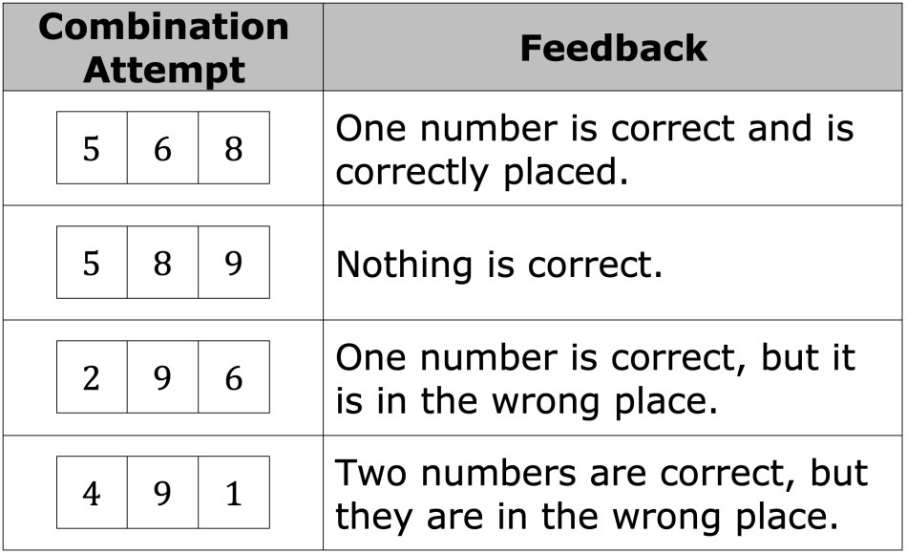
6.7.1 Warm-Up: Crack the Code
Feedback is given on four combination attempts to crack the code. Use the feedback on each attempt to crack the code.
volume 1, pg. 275

Slide 7
What is the code?
Explain why your code is correct.
volume 1, pg. 275

Slide 8

Exploration
volume 1, pg. 275

Slide 9

6.7.2 Exploration: Mirror, Mirror on the Ground
If an object is visible in a mirror positioned on the ground, then the measures of the angles of reflection from the eye to the mirror, and the mirror to the object are equal and similar triangles are created.
volume 1, pg. 275

Slide 10
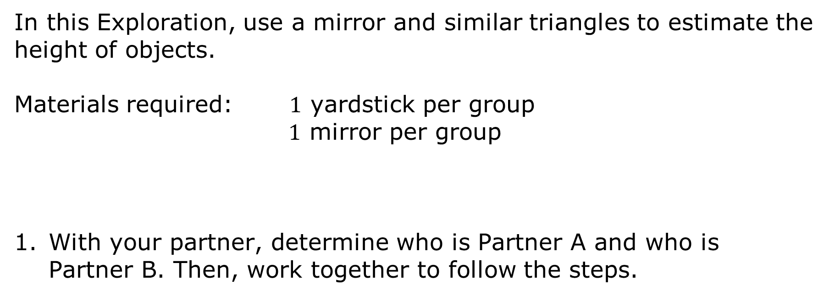
In this Exploration, use a mirror and similar triangles to estimate the height of objects.
Materials required: $1$ yardstick per group
$1$ mirror per group
With your partner, determine who is Partner A and who is Partner B. Then, work together to follow the steps.
volume 1, pg. 275

Slide 11
Step 1: Partner B measures the distance from the floor to Partner A’s eyes. Label the above diagram with the measurement.
Height of eye level: _____________ inches
Step 2: Partner A places the mirror on the floor between themselves and the object to be measured, then measures the distance from the base of the object to the center of the mirror. Label the measurement on the diagram.
volume 1, pg. 276

Slide 12
Step 3: Partner A starts at the mirror and walks backwards from the mirror and the object, stopping when the top of the object can be seen in the middle of the mirror.
Step 4: Partner A stays in place and Partner B measures the distance from Partner A’s feet to the middle of the mirror. Label the measurement on the diagram.
Step 5: Use your knowledge of similar triangles to estimate the height of the object.
volume 1, pg. 276

Slide 13
Repeat steps 2-5, alternating roles between Partner A and Partner B. Record your results in the table.
Object | Distance from Partner to Mirror | Distance from Object to Mirror | Work to Determine Approximate Height
volume 1, pg. 276

Slide 14

Your Turn
volume 1, pg. 277

Slide 15

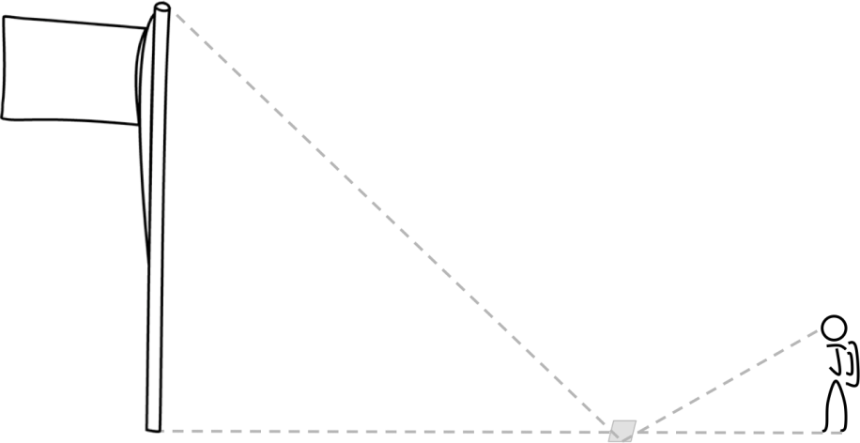
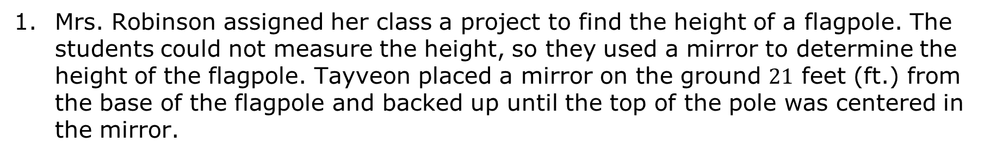
6.7.3 Your Turn!
Mrs. Robinson assigned her class a project to find the height of a flagpole. The students could not measure the height, so they used a mirror to determine the height of the flagpole. Tayveon placed a mirror on the ground $21$ feet (ft.) from the base of the flagpole and backed up until the top of the pole was centered in the mirror.
volume 1, pg. 277

Slide 16
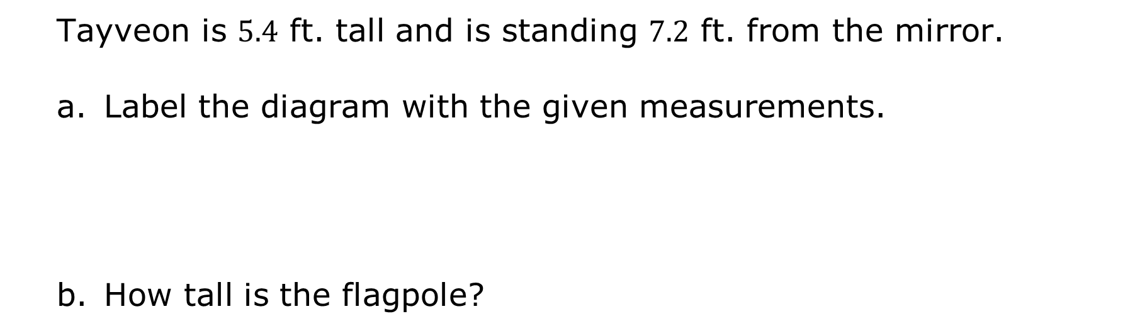
Tayveon is $5.4$ ft. tall and is standing $7.2$ ft. from the mirror.
Label the diagram with the given measurements.
How tall is the flagpole?
volume 1, pg. 277

Slide 17
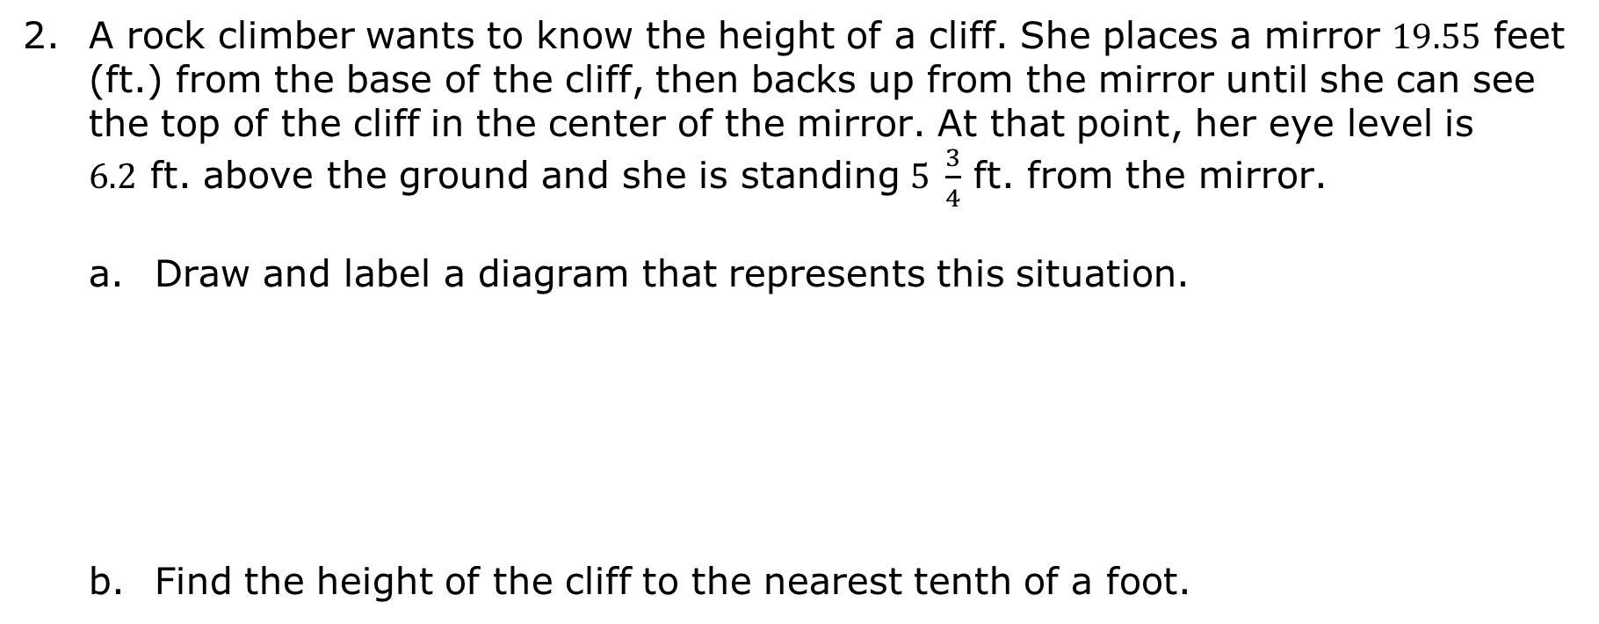
A rock climber wants to know the height of a cliff. She places a mirror $19.55$ feet (ft.) from the base of the cliff, then backs up from the mirror until she can see the top of the cliff in the center of the mirror. At that point, her eye level is $6.2$ ft. above the ground and she is standing $5 \frac{3}{4}$ ft. from the mirror.
Draw and label a diagram that represents this situation.
Find the height of the cliff to the nearest tenth of a foot.
volume 1, pg. 277

Slide 18

Wrap-Up
volume 1, pg. 278

Slide 19
6.7.4 Wrap-Up: Reflection
In this unit, there were three benchmarks. For each of the benchmarks, write one thing you feel confident you know and one thing you are still unsure about.
Benchmark | One thing I am confident I know is ... | One thing I am still unsure about is ...
MA.8.AR.3.1 Determine if a linear relationship is also a proportional relationship.
volume 1, pg. 278

Slide 20
Benchmark | One thing I am confident I know is ... | One thing I am still unsure about is ...
MA.8.AR.3.2 Given a table, graph or written description of a linear relationship, determine the slope.
MA.8.GR.2.4 Solve mathematical and real-world problems involving proportional relationships between similar triangles.
volume 1, pg. 278

